Slide 1




Wildfire Smoke Spread Prediction
Name : Abhinav V
College: Cochin University College of Engineering Kuttanad
Department: Computer Science And Engineering
Student_ID : STU6874d430053af1752486960
Email_ID : abhinavv305@ug.cusat.ac.in

Slide 2

Learning Objectives
Understand environmental and weather factors that influence wildfire risks.
Use machine learning for fire occurrence prediction.
Estimate fire intensity using regression.
GOAL
Deploy a user-friendly web interface using Streamlit.
Source :
www.freepik.com/

Slide 3
Tools and Technology used
• Python 3.x
• Jupyter Notebook (for development)
• scikit-learn (ML models)
• pandas, numpy, matplotlib, seaborn (data processing & visualization)
• Streamlit (web interface)
• Git & GitHub (version control)

Slide 4
Methodology
• Data Preprocessing (handle missing values, feature selection)
• Classification Model: Random Forest to predict fire occurrence
• Regression Model: Random Forest to estimate fire intensity (FRP)
• Model Evaluation: Accuracy, RMSE, R² Score, Confusion Matrix
• Deployment: Streamlit app with interactive inputs and outputs

Slide 5
Problem Statement:
Wildfires are becoming more frequent and dangerous due to climate change.
Manual prediction is difficult and often delayed.
Can we use weather/environmental data to automatically predict wildfire risk and intensity?

Slide 6
Solution:
• Developed two machine learning models using Random Forest: – A Classifier to predict wildfire occurrence (0 = No fire, 1 = Fire) – A Regressor to estimate fire radiative power (FRP), representing intensity
• Trained both models using key weather & environmental factors: fire weather index, temperature, humidity, wind speed, dewpoint, etc.
• Created a user-friendly Streamlit app for real-time prediction: – Users input weather conditions via sidebar – Displays fire prediction, fire probability (as progress bar), and FRP estimate – Shows feature importance charts and confusion matrix
• App supports demo mode if trained models are unavailable, making it fully testable
• Entire solution is modular, scalable, and deployable for public use

Slide 7
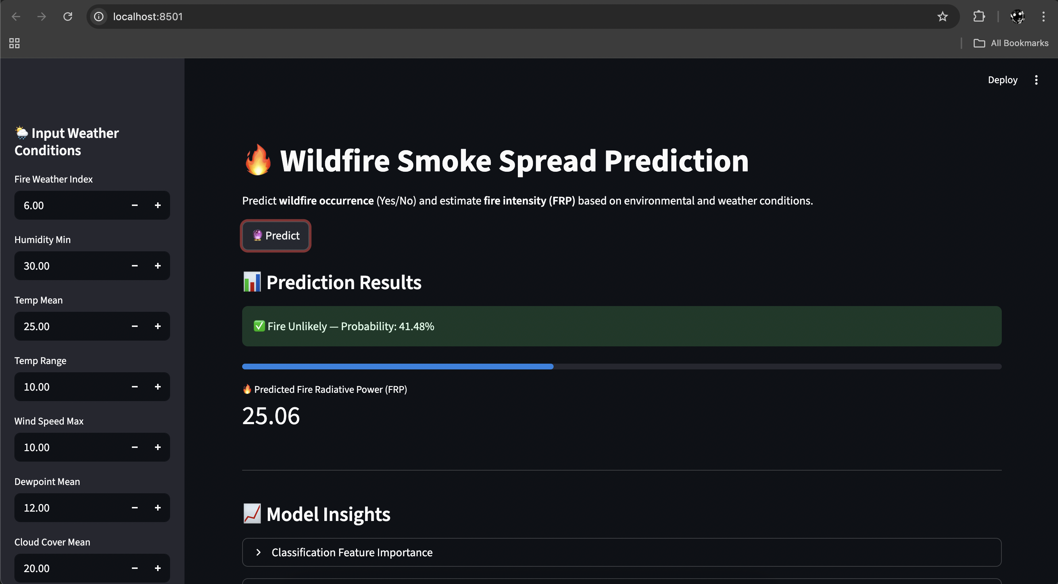
Screenshot of Output:

Slide 8
Conclusion:
• Built a complete ML pipeline for wildfire occurrence and intensity prediction.
• Achieved accurate classification and reliable FRP estimation.
• Deployed a working Streamlit app for public use and testing.
• Visual insights include feature importance & confusion matrix.
• Future scope: integrate live weather API or satellite data for real-time prediction.

